Slide 1
Cosc 3P92
Week 2 Lecture slides
The very first law in advertising is to avoid the concrete promise and cultivate the delightfully vague.
Bill Cosby (1937 - )

Slide 2
Gates and Circuits
• gates: NOT, AND, OR, NAND, NOR, XOR, ...
• eg. AND
• these are “logic” circuits that determine true or false values
(1 or 0 bits, or 2-5 volts and 0-1 volts)
• they can be implemented at the transistor level, and at an
extremely tiny scale (millions of gates on a chip)
  “device level”
Truth table:
a b c
0 0 0
0 1 0
1 0 0
1 1 1
a
b
c

Slide 3
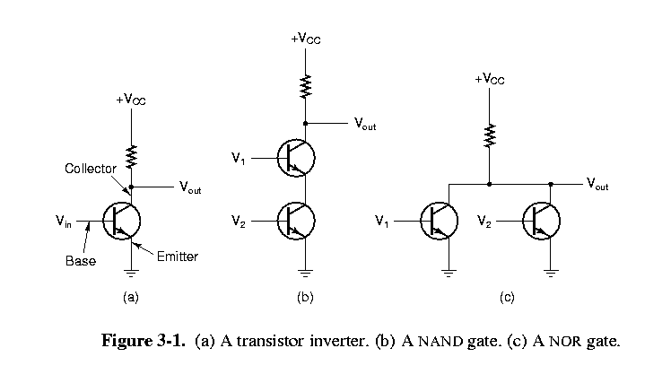
Transistor implementation

Slide 4
MOSFETs
From Wikipedia
MOSFET scaling (process nodes)
10 µm – 1971 6 µm – 1974 3 µm – 1977 1.5 µm – 1981 1 µm – 1984 800 nm – 1987 600 nm – 1990 350 nm – 1993 250 nm – 1996 180 nm – 1999 130 nm – 2001 90 nm – 2003
Future3 nm – ~2022
MOSFET scaling (process nodes)
90 nm – 2003 65 nm – 2005 45 nm – 2007 32 nm – 2009 22 nm – 2012 14 nm – 2014 10 nm – 2016 7 nm – 2018 5 nm – 2020
Future3 nm – ~2022

Slide 5
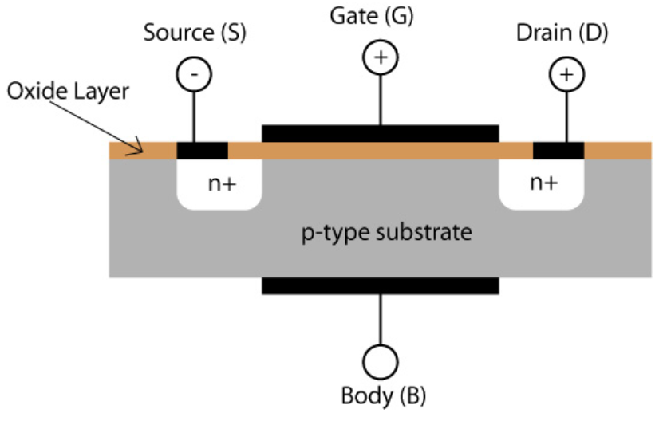
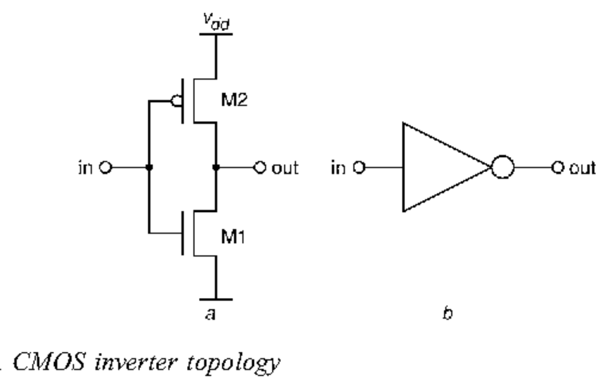
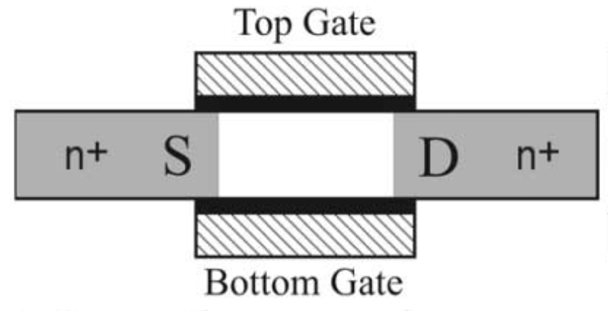
MOSFETs

Slide 6
Circuits
• Boolean algebra: functions over binary values
• NOT, NAND, NOR are most basic gates, and can be
use to create the rest; however, conceptually useful to
use AND and OR as well (and XOR,...)

Slide 7
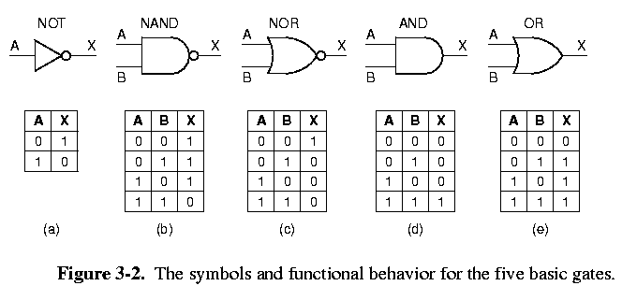
Circuits.

Slide 8
Circuits..
more complex functions over 3 + inputs are constructed using.
  basic gates
  method: construct a truth table of desired function, and then
  define a gate configuration for each ‘1’ of output column:
  1. write down truth table for function
  2. provide inverter for each input
  3. draw AND gate for each term with ‘1’ output in table
  4. wire AND gates to appropriate inputs (in table)
  5. feed all AND gates into an OR

Slide 9
Circuits...
such a circuit is probably not efficient (in gates or propagation time); lots of techniques for optimizing it (boolean algebra, karnaugh maps, ...)
mathematical properties of boolean logic permit formal, verifiable conversions on circuits

Slide 10
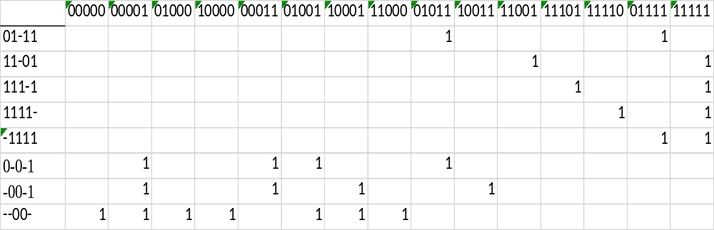
Quine McClusky final table

Slide 11
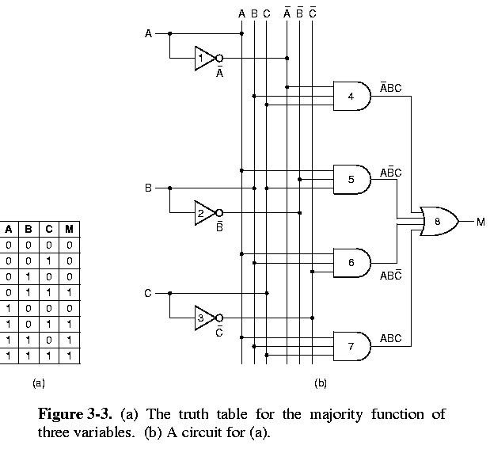
Circuits….

Slide 12
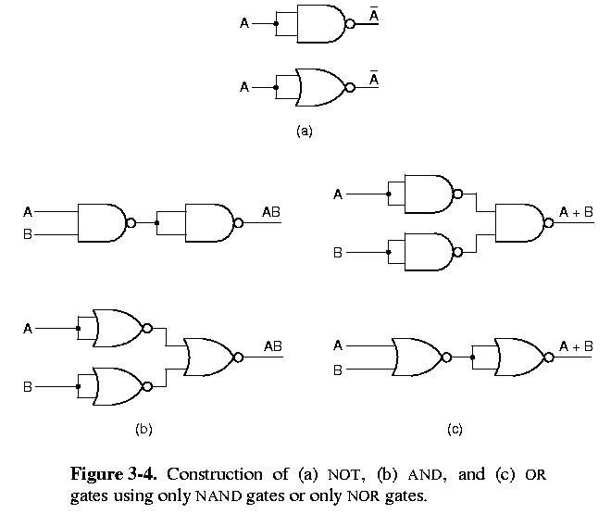
Nand and Nor

Slide 13
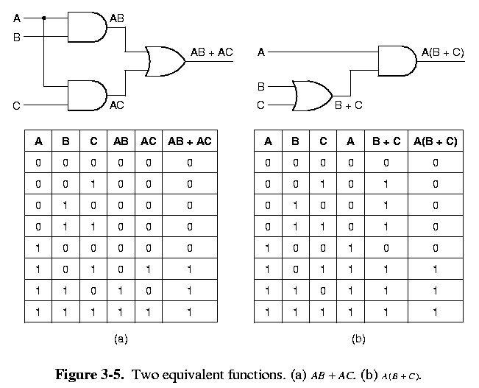
Nand and Nor Equivalence

Slide 14
Complex Circuits
digital logic is concerned with deriving arrays - configurations of gates (circuits) that:
  - compute the desired logical function
  - are inexpensive (fewest # gates, cheap gates)
  - are efficient (few # layers = fast propagation of signals)
Arbitrarily complex circuits can be derived this way
  - of course, practical limits to it
  - circuitry therefore designed hierarchically

Slide 15
VLSI
Digital circuits: large scale implementations of
  boolean functions.
  SSI - 1-10 gates
  MSI - 10-100 gates
  LSI - 100-100 000 gates
  VLSI - 100 000+
Goal: maximise gates (functions), minimize pin.
Can buy chips with basic gate functions: SSI chip

Slide 16
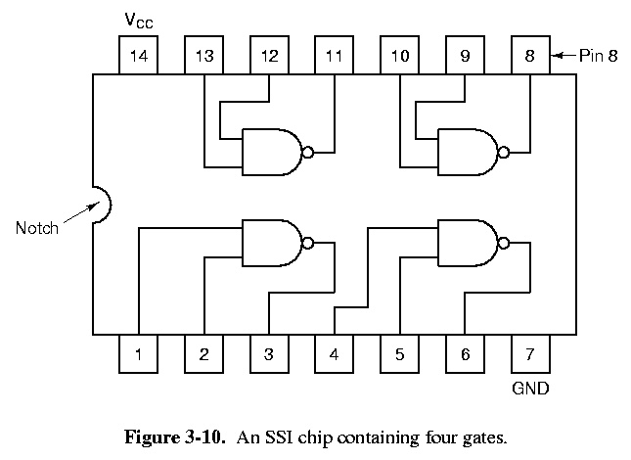
Off the Shelf Chips

Slide 17
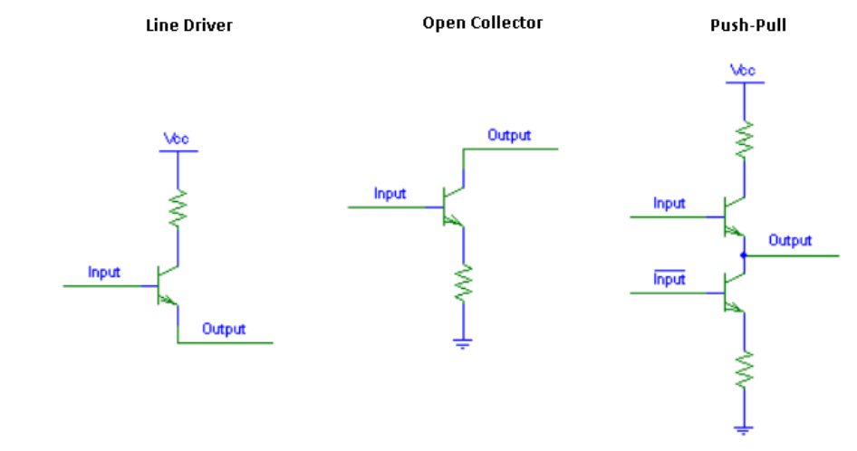
Totem Pole & Open Collector

Slide 18
Combinatorial Circuits
combinatorial circuits: outputs dependent upon input values
One convenient technique: provide general circuits that permit user definition of function: MSI chips
eg. multiplexer: 2^n data inputs, n control lines, 1 output
  each AND gate toggled by different combination of control; value specified by data input

Slide 19
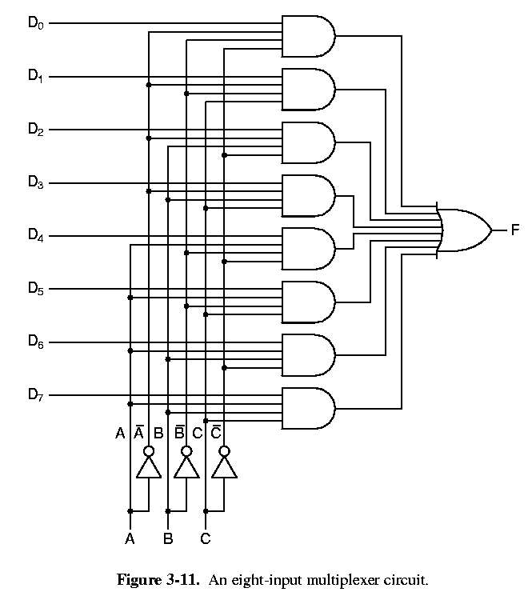
Combinatorial Circuits

Slide 20
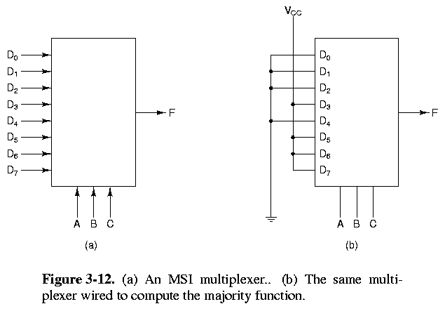
Combinatorial Circuits

Slide 21
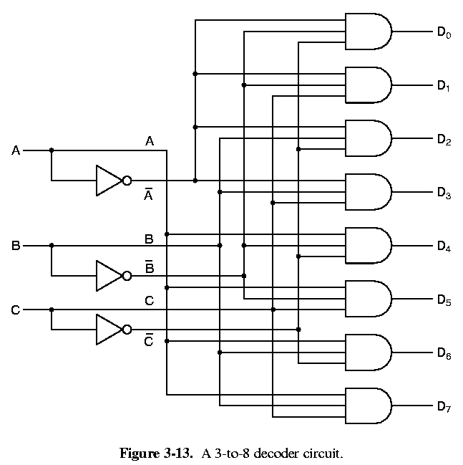
Combinatorial Circuits
Another MSI chip: decoder
  n inputs, 2^n outputs
  the binary number represented by input lines turns on that output line

Slide 22
Combinatorial Circuits
Yet another MSI: Programmed Logic Array (PLA)
  using truth table, user burns connections on this circuit, which effectively matches input data line patterns to appropriate output line patterns
possible to rewrite some PLA circuits; cheaper to mass-produce write-once ones.

Slide 23
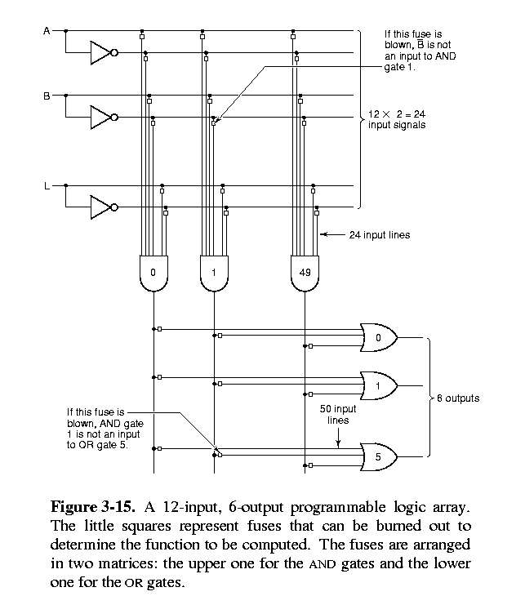

Slide 24
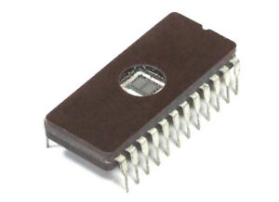
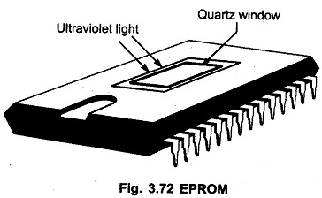
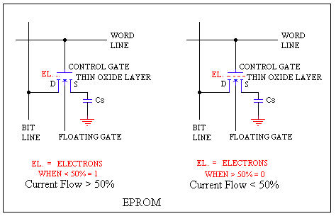
Eprom

Slide 25
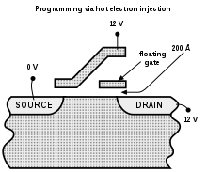

EEprom

Slide 26
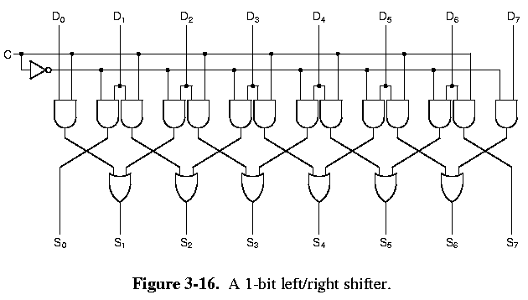
Arithmetic circuits
Shifter: bit manipulation

Slide 27
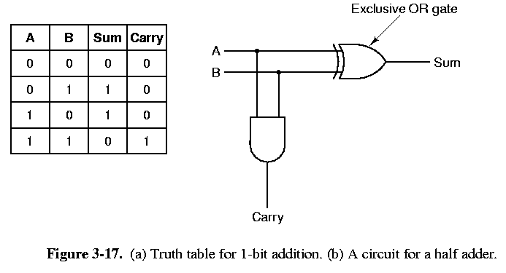
Adder
• Adder: basic addition (note: could do it with PLA too)

Slide 28
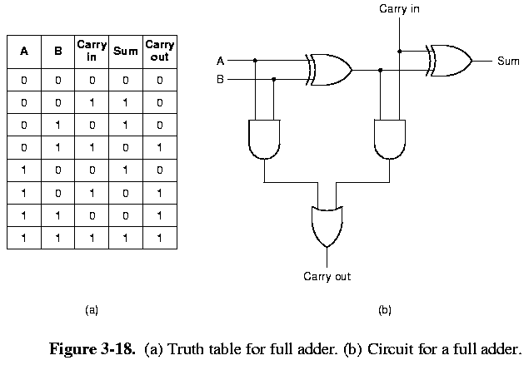
Adder.

Slide 29
Arithmetic circuits
subtraction, multiplication, etc, similarly implementable
ALU: arithmetic logic unit
  a general circuit that performs variety of arithmetic ops
  merges different circuits together, and is controlled by control lines
we can construct a 1-bit ALU; then connect multiple copies together for 8+-bit arithmetic

Slide 30
Arithmetic circuits
Simple 1 bit ALU units perform multiple functions.
Inputs A & B
Function Select F0 & F1
Carry in
Carry out
Output
GND
A
B
F0
F1
Vcc
Cin
Cout
OUT

Slide 31
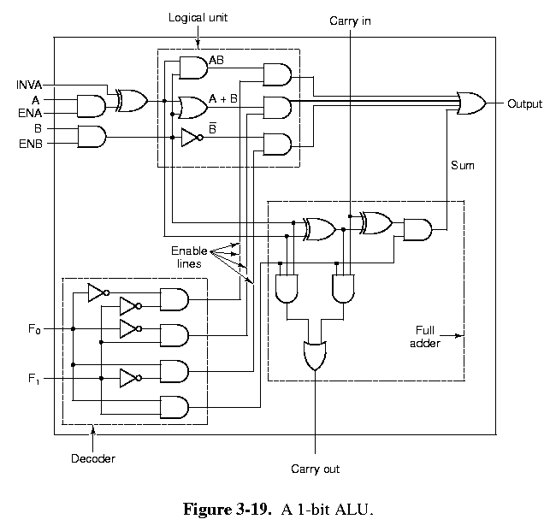
Inputs
Function Select

Slide 32
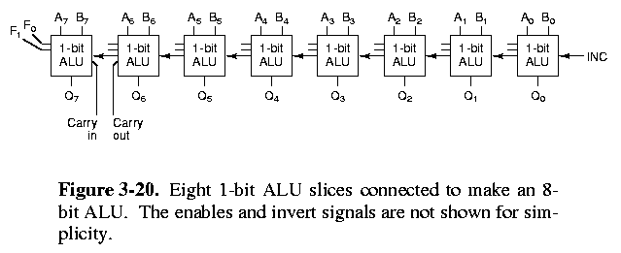
8 Bit ALU

Slide 33
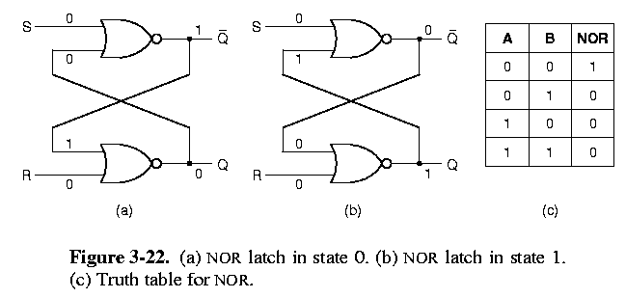
Memory circuits
memory: another basic component designed by simple (convoluted) gate circuitry
eg. clocked D-latch
  set D input to value, and when clock occurs, D value is retained on Q output
  D can then change with no effect to Q, unless another clock
--> can save a bit value!

Slide 34
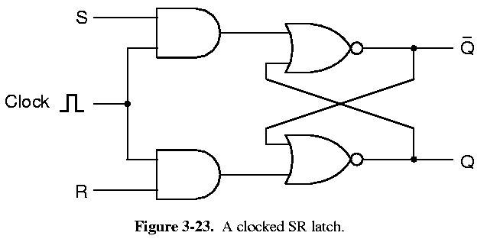
SR Latch

Slide 35
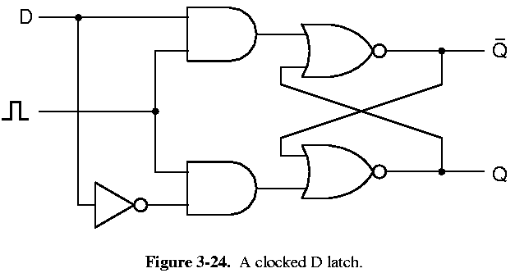
Clocked D Latch
clocked D-latch
  set D input to value, and when clock occurs, D value is retained on Q output
  D can then change with no effect to Q, unless another clock

Slide 36
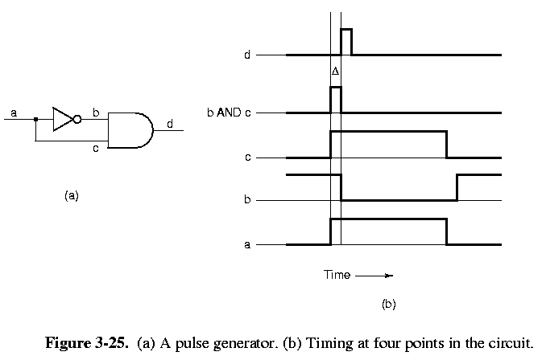
Flip-Flops
• flip-flop: similar, but trigger by clock state change
(edge triggered)

Slide 37
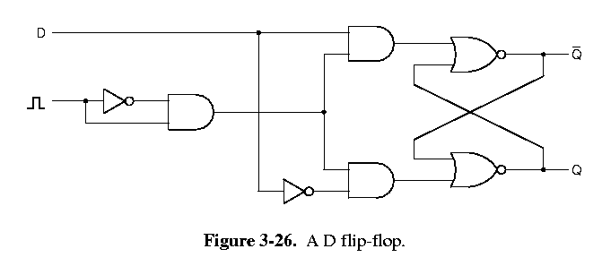
Flip Flops.

Slide 38
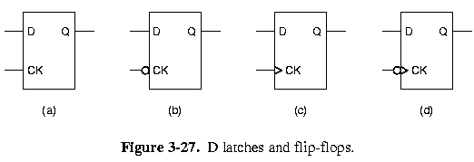
Flip Flops

Slide 39
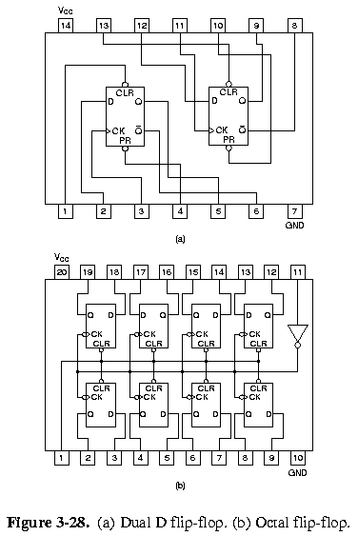
Memory circuits

Slide 40
Memory circuits
collect 8 1-bit flip flops together: 8 bit register!
each flip-flop retains 1 bit of a byte
  impractical to extend this scheme to mass memory
  (millions of pins - 1 pin per bit in memory!)
solution: use address lines
  we refer to groups of bits (words) to save via an ID number
  hence an address
this permits logarithmic growth of pins for increasing memory store.
  Address lines are decoded to enable 1 word of memory.

Slide 41
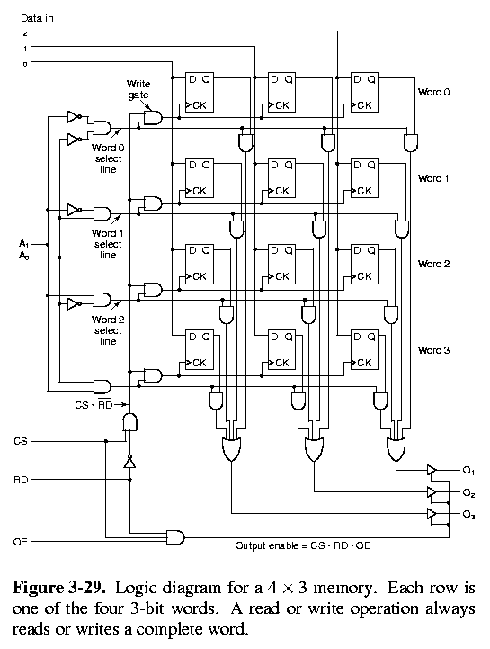
4 x 3 Memory
Data input lines,
Address lines, Decoded to enable 1 of the 4 words
Chip Select, Note Input and output is enabled when high
Buffered Data output lines,
Read Enable, Low = write to memory. High = read from memory
O/P Enable,

Slide 42
Memory circuits
(14 pin chip)
  data inputs I0, I1, I2
  address A0, A1
  control: CS - chip select, RD - read/write,
  OE - output enable
  data outputs O0, O1, O2
To write to chip:
  1. I1, I2, I3 set to data value to save
  2. Ai’s set
  3. CS = 1, RD = 0
  4. Then I’s are saved
To read from chip:
  1. Ai’s set
  2. CS=1, RD=1, OE=1
  3. Then values dumped onto Oi’s

Slide 43
Memory Circiuts
4 AND gates at left are a decoder: select 1 of 2^2 = 4 words
  for write: CS*RD^ is high, and data in I lines is latched into flip flops at clock cycle
  for read: the flip flops at addressed word are sent to output, but flip flop values are not changed
lines in circuit always indicate current data
  RD=1 (=OE=CS) causes them to be output onto O_{i} lines

Slide 44
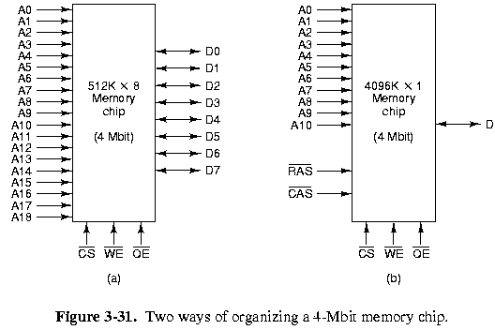
Memory circuits
This is easily extended to megabytes of store

Slide 45
Memory circuits
memory circuits are repetitive and well-suited to implementation on VLSI chips
capacity doubles every few years
  (18 months, “Moore’s Law”)
Types of memory:
RAM: circuits we’ve looked at
  static RAM: retain values as long as there’s a power supply
  dynamic RAM: must be refreshed at intervals, permit greater capacity than static
  ROM: data burnt into circuit
  PROM: can program data into chip once
  EPROM: can reprogram data into chip using special H/W using ultraviolet light
  EEPROM : like EPROM but uses electric pulses

Slide 46
ROM
Addressed Bit.
If 1 and not diode then output is 0.
o/p
Addressed Bit.
If 1 and a diode then output is pulled to 1.
o/p

Slide 47
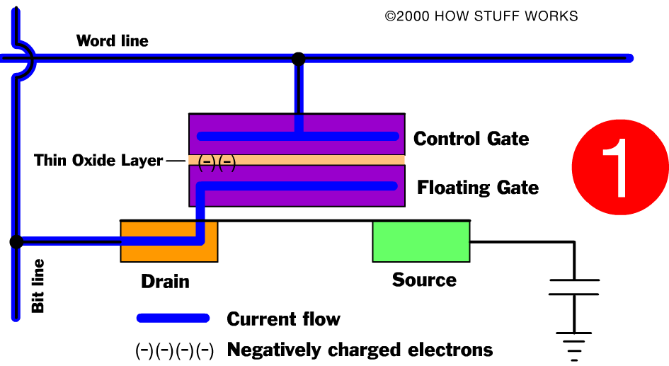
EPROM http://static.howstuffworks.com/flash/rom-epromgate.swf

Slide 48
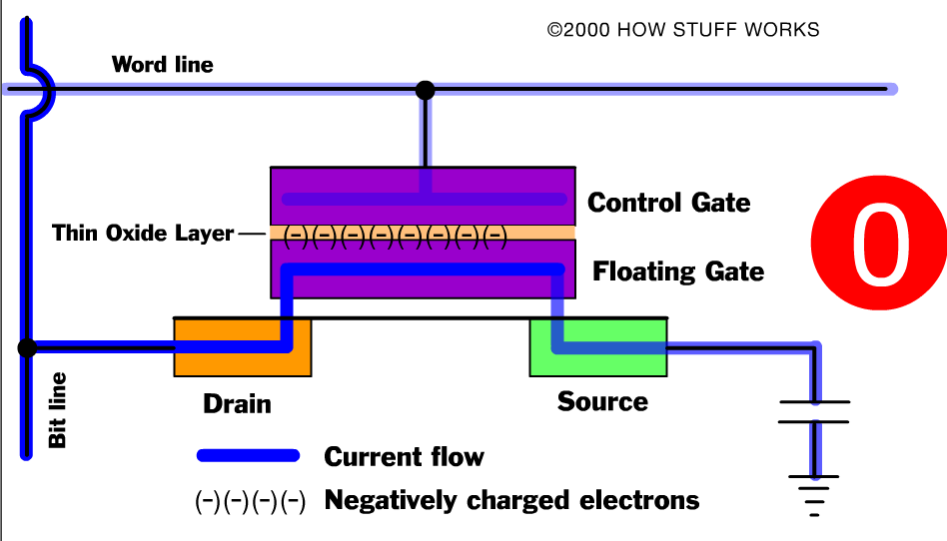
EPROM.

Slide 49
PROMs
Blank PROMs have output all 1's.
  Because, Oxide layer is not charged, thus Control Gate blocks Source to Drain flow.
  O/p stays 1
Programmer will charge the "Thin oxide Layer" with negative electrons.
  These will inhibit the Control Gate from influencing the Source to Drain flow.
  O/P is pulled low or 0.
UV light destroys the charge on the Oxide layer thus erasing the info stored.

Slide 50
EEPROM & Flash
EEPROM erases a localized byte using an electric field.
  This replaces the use of UV Light
  Too slow for most operations
  Typical uses include Computer BIOS
Flash is an extension on EEPROM.
  Uses block erase and program.
  Stores in 512K blocks.
  Much Faster then EEPROM.
  Typical uses include, digital cameras
  Using buffers, speed now exceeds hard drive technology
    3 or 4 times faster.

Slide 51
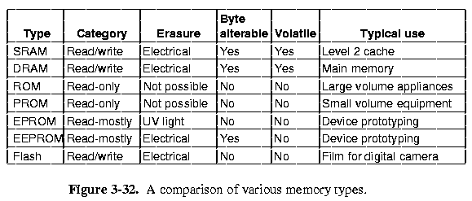
Comparison of Memory

Slide 52
The end

